Slide 1
Multiple Regression Analysis with Qualitative Information

Slide 2
Multiple Regression Analysis with Qualitative Information
Qualitative Information
  Examples: gender, race, industry, region, rating grade, …
  A way to incorporate qualitative information is to use dummy variables
  They may appear as the dependent or as independent variables
A single dummy independent variable
= the wage gain/loss if the person is a woman rather than a man (holding other things fixed)
Dummy variable:
=1 if the person is a woman
=0 if the person is man

Slide 3
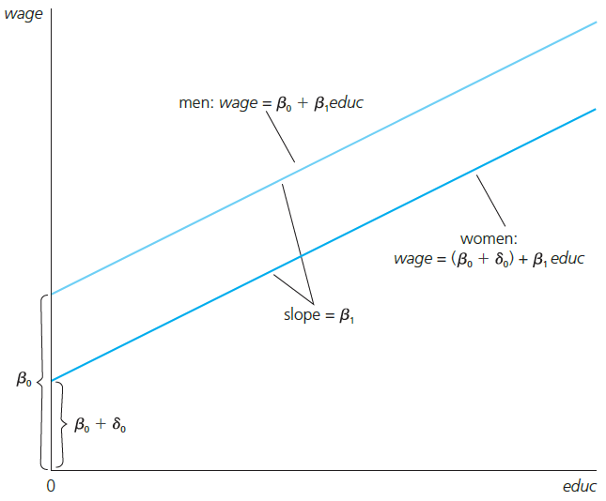
Multiple Regression Analysis with Qualitative Information
Graphical Illustration
Alternative interpretation of coefficient:
i.e. the difference in mean wage between men and women with the same level of education.
Intercept shift

Slide 4
Multiple Regression Analysis with Qualitative Information
Dummy variable trap
This model cannot be estimated (perfect collinearity)
When using dummy variables, one category always has to be omitted:
The base category are men
The base category are women
Alternatively, one could omit the intercept:
Disadvantages:
1) More difficult to test for diffe-rences between the parameters
2) R-squared formula only valid
if regression contains intercept

Slide 5
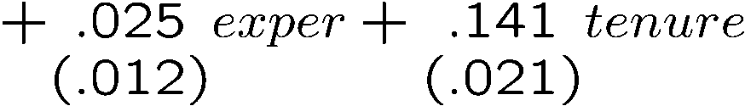

Multiple Regression Analysis with Qualitative Information
Estimated wage equation with intercept shift
Does that mean that women are discriminated against?
  Not necessarily. Being female may be correlated with other produc-tivity characteristics that have not been controlled for.
Holding education, experience, and tenure fixed, women earn $1.81 less per hour than men

Slide 6
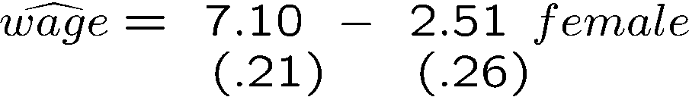

Multiple Regression Analysis with Qualitative Information
Comparing means of subpopulations described by dummies
Discussion
  It can easily be tested whether difference in means is significant
  The wage difference between men and women is larger if no other things are controlled for; i.e. part of the difference is due to differ-ences in education, experience, and tenure between men and women
Not holding other factors constant, women earn $2.51per hour less than men, i.e. the difference between the mean wage of men and that of women is $2.51.

Slide 7
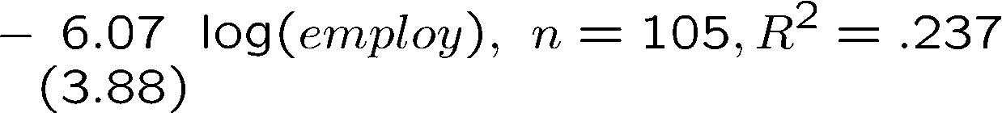
Multiple Regression Analysis with Qualitative Information
Further example: Effects of training grants on hours of training
This is an example of program evaluation
  Treatment group (= grant receivers) vs. control group (= no grant)
  Is the effect of treatment on the outcome of interest causal?
Hours training per employee
Dummy variable indicating whether firm received a training grant

Slide 8
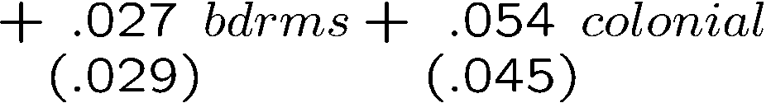


Multiple Regression Analysis with Qualitative Information
Using dummy explanatory variables in equations for log(y)
Dummy indicating whether house is of colonial style
As the dummy for colonial style changes from 0 to 1, the house price increases by 5.4 percentage points

Slide 9
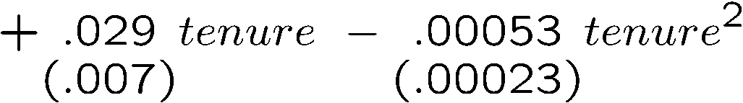

Multiple Regression Analysis with Qualitative Information
Using dummy variables for multiple categories
  1) Define membership in each category by a dummy variable
  2) Leave out one category (which becomes the base category)
Holding other things fixed, married women earn 19.8% less than single men (= the base category)

Slide 10
Multiple Regression Analysis with Qualitative Information
Incorporating ordinal information using dummy variables
Example: City credit ratings and municipal bond interest rates
Municipal bond rate
Credit rating from 0-4 (0=worst, 4=best)
This specification would probably not be appropriate as the credit rating only contains ordinal information. A better way to incorporate this information is to define dummies:
Dummies indicating whether the particular rating applies, e.g. CR₁=1 if CR=1, and CR₁=0 otherwise. All effects are measured in comparison to the worst rating (= base category).

Slide 11






Multiple Regression Analysis with Qualitative Information
Interactions involving dummy variables
Allowing for different slopes
Interesting hypotheses
Interaction term
= intercept men
= slope men
= intercept women
= slope women
The return to education is the same for men and women
The whole wage equation is the same for men and women

Slide 12
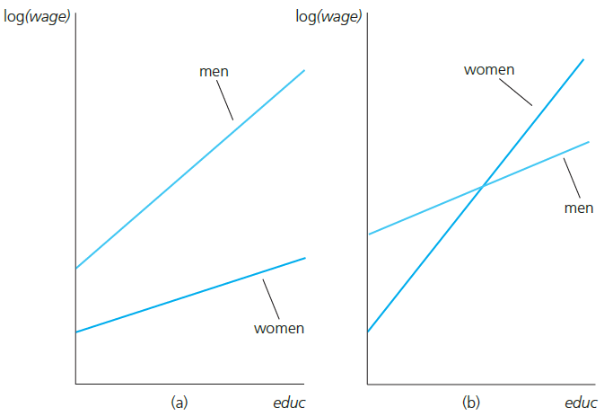
Multiple Regression Analysis with Qualitative Information
Graphical illustration
Interacting both the intercept and the slope with the female dummy enables one to model completely independent wage equations for men and women

Slide 13
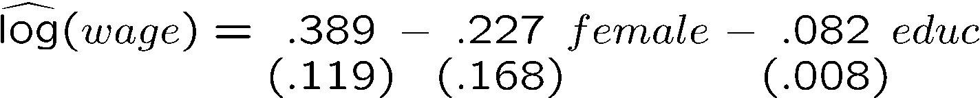
Multiple Regression Analysis with Qualitative Information
Estimated wage equation with interaction term
Does this mean that there is no significant evidence of lower pay for women at the same levels of educ, exper, and tenure? No: this is only the effect for educ = 0. To answer the question one has to recenter the interaction term, e.g. around educ = 12.5 (= average education).
No evidence against hypothesis that the return to education is the same for men and women

Slide 14
Multiple Regression Analysis with Qualitative Information
Testing for differences in regression functions across groups
Unrestricted model (contains full set of interactions)
Restricted model (same regression for both groups)
College grade point average
Standardized aptitude test score
High school rank percentile
Total hours spent
in college courses

Slide 15

Multiple Regression Analysis with Qualitative Information
Null hypothesis
Estimation of the unrestricted model
All interaction effects are zero, i.e. the same regression coefficients apply to men and women
Tested individually, the hypothesis that the interaction effects are zero cannot be rejected

Slide 16

Multiple Regression Analysis with Qualitative Information
Joint test with F-statistic
Alternative way to compute F-statistic in the given case
  Run separate regressions for men and for women; the unrestricted SSR is given by the sum of the SSR of these two regressions
  Run regression for the restricted model and store SSR
  If the test is computed in this way it is called the Chow-Test
  Important: Test assumes a constant error variance accross groups
Null hypothesis is rejected

Slide 17

Multiple Regression Analysis with Qualitative Information
A Binary dependent variable: the linear probability model
Linear regression when the dependent variable is binary
If the dependent variable only takes on the values 1 and 0
Linear probability model (LPM)
In the linear probability model, the coefficients describe the effect of the explanatory variables on the probability that y=1

Slide 18
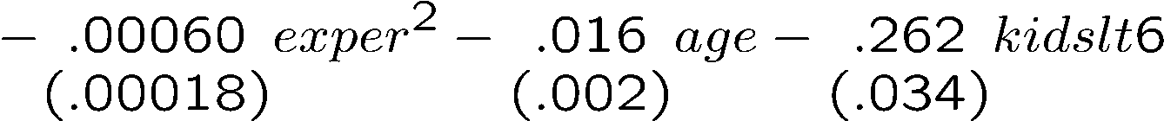
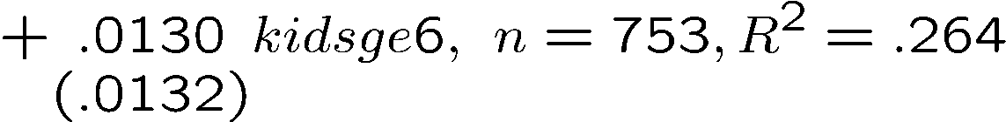
Multiple Regression Analysis with Qualitative Information
Example: Labor force participation of married women
=1 if in labor force, =0 otherwise
Non-wife income (in thousand dollars per year)
If the number of kids under six years increases by one, the pro- probability that the woman works falls by 26.2%
Does not look significant (but see below)

Slide 19
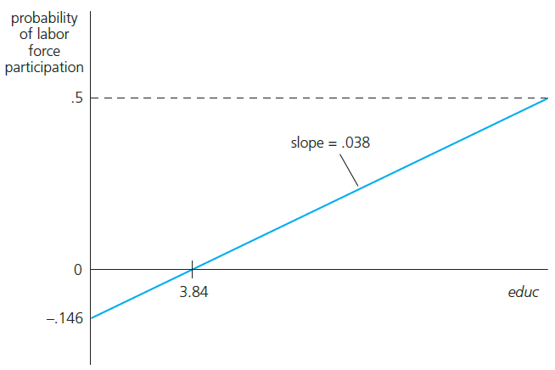
Multiple Regression Analysis with Qualitative Information
Example: Female labor participation of married women (cont.)
Graph for nwifeinc=50, exper=5, age=30, kindslt6=1, and kidsge6=0
The maximum level of education in the sample is educ=17. For the gi-ven case, this leads to a predicted probability to be in the labor force of about 50%.
Negative predicted probability but no problem because no woman in the sample has educ < 5.

Slide 20
Multiple Regression Analysis with Qualitative Information
Disadvantages of the linear probability model
  Predicted probabilities may be larger than one or smaller than zero
  Marginal probability effects sometimes logically impossible
  The linear probability model is necessarily heteroskedastic
  Heteroskedasticity consistent standard errors need to be computed
Advantanges of the linear probability model
  Easy estimation and interpretation
  Estimated effects and predictions are often reasonably good in practice
Variance of Ber-noulli variable

Slide 21
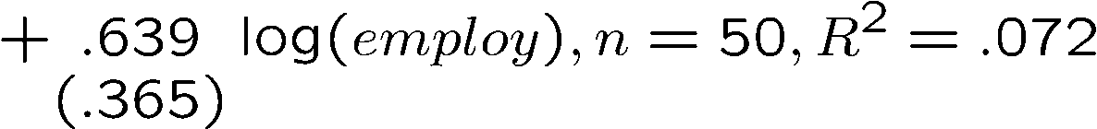
Multiple Regression Analysis with Qualitative Information
More on policy analysis and program evaluation
Example: Effect of job training grants on worker productivity
The firm‘s scrap rate
=1 if firm received training grant, =0 otherwise
No apparent effect of grant on productivity
Treatment group: grant receivers, Control group: firms that received no grant
Grants were given on a first-come, first-served basis. This is not the same as giving them out randomly. It might be the case that firms with less productive workers saw an opportunity to improve productivity and applied first.

Slide 22
Multiple Regression Analysis with Qualitative Information
Self-selection into treatment as a source for endogeneity
  In the given and in related examples, the treatment status is probably related to other characteristics that also influence the outcome
  The reason is that subjects self-select themselves into treatment depending on their individual characteristics and prospects
Experimental evaluation
  In experiments, assignment to treatment is random
  In this case, causal effects can be inferred using a simple regression
The dummy indicating whether or not there was treatment is unrelated to other factors affecting the outcome.

Slide 23
Multiple Regression Analysis with Qualitative Information
Further example of an endogenous dummy regressor
  Are nonwhite customers discriminated against?
  It is important to control for other characteristics that may be important for loan approval (e.g. profession, unemployment)
  Omitting important characteristics that are correlated with the non-white dummy will produce spurious evidence for discrimination
Dummy indicating whether loan was approved
Race dummy
Credit rating

